Slide 1
Web Dev Intensive
Elias Carlston, DevelopIntelligence
elias@eliascarlston.com
https://github.com/eliasjames/training-web-dev

Slide 2
Day 1 Schedule
Introductions / Icebreakers
Course Overview
Intro to SQA & Web Development
Lunch
Advanced HTML
Intro to CSS

Slide 3
Introductions
About me
About you
Your name & brief experience
Something you look forward to learning
Something non-work related

Slide 4
Course Overview
Day 1
Principles of Software Quality Assurance
Web Development Basics
Developer Tools
Intro to HTML, HTML5, and Semantic markup
Intro to CSS

Slide 5
Course Overview
Day 2
JavaScript Introduction
Basic Objects, Arrays, and Loops
TDD in Practice
Functions
Prototypal Inheritance

Slide 6
Course Overview
Day 3
JavaScript Best Practices / Architecture
Testable Objects Patterns
Testable Callback Patterns
Refactoring

Slide 7
Course Overview
Day 4
Intro to JavaScript Testing Tools
Testable DOM Manipulation
Testable Event Handling
Testable jQuery Introduction

Slide 8
Course Overview
Goals
Perspective to make good engineering decisions
Grounding in web dev fundamentals
Familiarity with web dev tools
Familiarity with test processes

Slide 9
Course Overview
Fundamental concepts
Some information may feel like review for you
May not be review for your neighbor
History helps to understand present
Fundamental concepts deserve review

Slide 10
Course Overview
Fundamental concepts
Modern web built in layers on layers
We'll learn the hard way first
To understand underlying principles
Then we'll see the easy way after

Slide 11
Course Overview
Guiding Principles
Simple and clear
Small pieces
Separation of Concerns / Single Responsibility

Slide 12
SQA
Software Quality Assurance (SQA)
More than just testing
Design and development
Architecture best practices
Version control
Code reviews

Slide 13
SQA
Design and development
Design phase must have adequate time
(software design, not just product design)
Document design decisions
Work in small, verifiable increments
Style guide (formatting and naming conventions)

Slide 14
SQA
Architecture Best Practices
Security, Stability, Scalability
Single Responsibility Principle / Separation of Concerns
Consider inputs, outputs, and state mutations

Slide 15
SQA
Version control
A requirement on any and every project
Therefore, ease of use is critical
Complicated branching strategies discouraged

Slide 16
SQA
Code reviews
Goal: increase overall code quality
Single most effective tactic to catch bugs
Amazing what a second set of eyes can see
Creates knowledge-sharing among team
Positive, open attitude required from all involved

Slide 17
SQA
Code reviews - slightly NSFW

Slide 18
Lab: SQA Setup
Set up our work environment
Create a new folder (outside class repo)
Following steps within new folder:
'git init' to create new git repo
Create a hello-world.txt
'git add .', 'git commit -m "your message"'
'git rm hello-world.txt', 'git commit'

Slide 19
Lab: SQA Design
Design implementation for TicTacToe game
In plain english, describe requirements (what)
Avoid implementation details (how)
Imagine protocol for playing TTT over telephone
Focus on MVP (Minimum Viable Product)
The smallest amount of functionality to solve

Slide 20
Lab: Code Review
Pair up & take turns
Presenter: walk your partner through your work
Reviewer
Positive attitude required
Focus on best practices - respect choices
Present suggestions / options, not solutions

Slide 21
Web Dev Basics
What is the Web?
At its most basic, Request and Response
Client makes a request to Server
Client handles the Server's response

Slide 22

Web Dev Basics
What is the Web?
Server
Request
Client
…wait…
Client:
"Page not found"
Response
Client changes
"state"

Slide 23
Web Dev Basics
Clients
Browsers
Mobile Apps
Voice Browser ("Screen Reader")
Web crawler ("Robot")

Slide 24
Web Dev Basics
Server / Host
A Server accepts connections from clients
A host is a network device providing resources
May be the same machine - client doesn't know

Slide 25
Web Dev Basics
Domain Name Service (DNS)
Like a phone book
Turns a human-friendly name into IP address
'google.com' -> 172.16.254.1
A server at that IP "listens" on Port 80 (HTTP)

Slide 26
Web Dev Basics
Uniform Resource Locator (URL)
http://google.com/news/today#sports
scheme:[//[user:password@]host[:port]][/]path[?query][#fragment]

Slide 27
Web Dev Basics
HTTP
Hyper Text Transfer Protocol
Defines communication methods
Two types, Request and Response
Response often includes HTML
Stateless - each Response ends transaction

Slide 28
Lab: Use curl
First…
Mac: open Terminal
Windows: open git bash, or https://curl.haxx.se/
Then
'curl -v google.com'
'curl -v www.google.com'

Slide 29
Web Dev Basics
HTTP Request
Specify a resource (noun) and a method (verb)
Common methods
GET: retrieve data ("safe" - does nothing else)
POST: add request body to a resource
PUT, DELETE, OPTIONS

Slide 30
Web Dev Basics
Common HTTP Request Headers
Accept (content-types)
Cookie
Origin
User-Agent

Slide 31
Web Dev Basics
Common HTTP Response Headers
Access-Control-Allow-Origin
Cache-Control
Content-[ Type | Language Location ]
Set-Cookie
Status

Slide 32
Web Dev Basics
HTTP Status Codes
1xx Informational
2xx Success
3xx Redirection
4xx Client Error
5xx Server Error

Slide 33
Lab: More HTTP
Install Postman app, then
Visit http://requestb.in/
Follow instructions
Create a new bin
Submit POST / PUT / DELETE requests
Examine results

Slide 34
HTML
What is HTML?
Hyper Text Markup Language
Gives semantic structure to content
"Mark up" human-readable content by adding machine-readable content
The foundation of any web app
Not for display / presentation

Slide 35
HTML
History
Invented by Tim Berners-Lee at CERN
Inspired by SGML, an earlier markup from IBM
Intended for physicists to share white papers
Took its guidance from outline format
List, section, header, paragraph

Slide 36
HTML
Semantics
Syntax : Semantics :: Grammar : Meaning
Elements add semantic meaning
Humans recognize list, section, header, etc
Machines need a little help

Slide 37
HTML
HTML Syntax
<element-name attribute-name="value">
Element innerHTML <another-element>
</element-name>
Case insensitive, lower case preferred
Double quotes required
Closing tag depends whether element can contain others

Slide 38
HTML
HTML Document structure
Document begins with <html> element
Contains <head> and <body>
<head> contains metadata about the document
<body> contains document content

Slide 39
HTML
<!-- from https://www.sitepoint.com/a-basic-html5-template/ -->
<!doctype html>
<html lang="en">
<head>
<meta charset="utf-8">
<title>The HTML5 Herald</title>
<meta name="description" content="The HTML5 Herald">
<meta name="author" content="SitePoint">
<link rel="stylesheet" href="css/styles.css?v=1.0">
<!--[if lt IE 9]>
<script src="https://cdnjs...html5shiv.js"></script>
<![endif]-->
</head>
<body>
<h1>Most Important</h1>
<script src="js/scripts.js"></script>
</body>
</html>

Slide 40
HTML
Style guide - why have one?
Many styles are a matter of taste
Codebase should look like it had one author
Following the guide more important than taste
Proper indentation is not just taste
Indenting is critical to visual organization

Slide 41
HTML
Common style rules
Indent nested tags
Use two spaces for indenting
Break long elements (>80 chars) into multi lines
Use whitespace to separate functional sections

Slide 42
HTML
Fault Tolerance
Browsers will "fix" a lot of problem HTML
Unrecognized elements
Unmatched close tags
Invalid attributes
This can be good and bad

Slide 43
HTML
Validation
Automatic validation identifies HTML errors
Bad HTML can cause insidious problems
SEO / ADA penalties
JavaScript errors

Slide 44
HTML
Validation
Many good tools online
Various browser & editor plugins available
www.w3cvalidator.org a good place to start

Slide 45
HTML
Common validation errors
Some tags and elements are required
<!doctype html>, <meta charset>
Some tags can't nest within others
Header tags (<h*>), <input> within <table>
<img> tags require 'alt' attribute

Slide 46
Lab: Validation
Validate any HTML at www.w3cvalidator.org
Examine results & fix errors
Find some other validation rules
Intentionally invalidate
Examine what happens in browser

Slide 47
Lab: Design HTML
Design implementation for HTML file
Review requirements document from earlier
Create a new text document
Declare features to be supported
Choose appropriate HTML elements
Document design decisions

Slide 48
Lab: First HTML
Create HTML file from Design
Start from template in class repo
Add markup to support features
Commit
Validate
Code review

Slide 49
HTML
Document Object Model (DOM)
Browser parses HTML
Creates a representation in memory
DOM is in memory
HTML : recipe :: DOM : food

Slide 50
HTML
Document Object Model (DOM)
Parse turns HTML markup into DOM objects
HTML 'elements' become DOM 'nodes'
Element attributes become object properties
All user interaction in browser is with DOM

Slide 51
HTML
Chrome Developer Tools
View > Developer > Developer Tools
Or, right-click and choose "Inspect Element"
If not already, choose "Elements" from menu

Slide 52
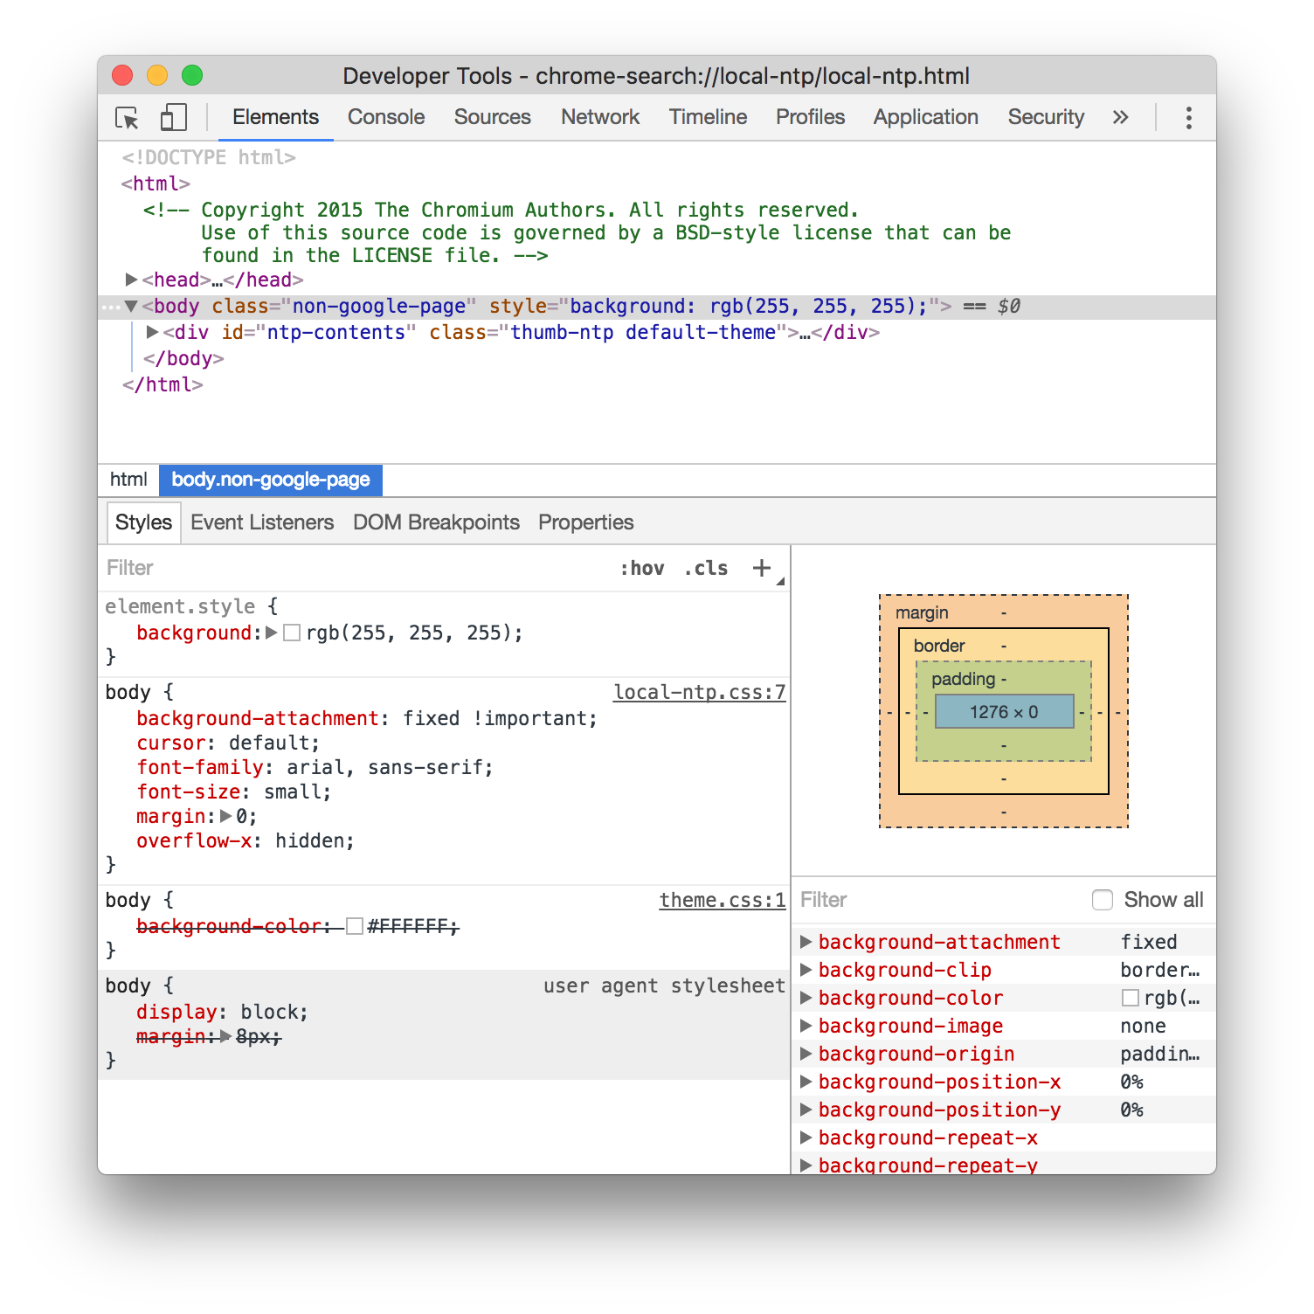
HTML
Chrome Developer Tools

Slide 53
Lab: Dev Tools
Examine HTML page with Dev Tools
Modify elements & attributes, observe results
Reload page

Slide 54
Advanced HTML
HTML Spec
Version 4 finalized in 2000
A lot changed since then
Spec didn't change until 2014
What happened?

Slide 55
Advanced HTML
HTML Spec
Browsers started supporting new features
<video>, SVG, geolocation, oh my!
HTMLWG couldn't / didn't keep up
Fault tolerance ~= future proofing

Slide 56
Advanced HTML
HTML5
Spec used to declare what should be implemented
Didn't work out great (JavaScript, CSS wars)
HTML5 flipped the order
Described the consensus usage of what already existed

Slide 57
Advanced HTML
HTML5
HTML5 is a group of features
Browsers support as many as they can
Developer is responsible for either
Progressive enhancement
Graceful degradation

Slide 58
Advanced HTML
HTML5 additions
New functional elements: <video>, <canvas> etc.
JavaScript: APIs like geolocation, local storage
JavaScript ES6 often lumped in with HTML5
Semantic elements

Slide 59
Semantic Elements
Remember voice browsers?
They need an equivalent experience
<div> and <span> got overused for formatting
Use semantic elements instead

Slide 60
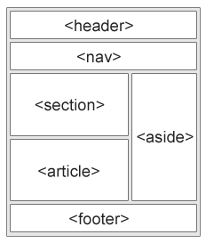
Semantic Elements
Instead of multiple <div>…

Slide 61
Semantic Elements
<details> - Additional info the user can view or hide
<summary> - heading for <details>
<figure> - Content, like images, code, etc.
<figcaption> - caption an <img> within <figure>
<main> - Specifies the main content of a document
<mark> - Defines marked/highlighted text
<time> - Defines a date/time

Slide 62
Semantic Elements
New Input Types
date/time/-local, number, range, search, tel, url
Older browsers treat new tags as type="text"
New Input Attributes
autocomplete, form, list, multiple, pattern

Slide 63
Lab: HTML5 UI
Add common UI elements
Header with nav menu
TTT game in main content
Sidebar with player info
Footer

Slide 64
Intro to CSS
What is CSS?
Cascading Style Sheets
Controls visual display (presentation)
Move visual attributes out of HTML
Two part syntax: Selectors and Rules

Slide 65
Intro to CSS
Selector
body {
border: 1px solid red;
color: lightblue;
}
div.some-class {
background-image: #ffffff url("img_tree.png") no-repeat right top;
font-size: 3em;
margin: 3px 2px 3px 2px;
padding: 3px 2px; padding-left: 4px;
}
Rule
Properties

Slide 66
Intro to CSS
Selectors
Expressions which describe sets of elements
Set may have many members, or none
Rules applied to DOM nodes in sets
Selectors also used for identifying / retrieving sets - without rules

Slide 67
Intro to CSS
Selector atoms
Tag: any HTML tag
Class
User-meaningful text string ( 'sale-items' )
Elements can have multiple classes
ID: like class, but must be unique per document

Slide 68
Intro to CSS
Selector atoms syntax
Tag: HTML tag directly - 'a' or 'div'
Class: dot before text string - '.sale-items'
ID: pound before text string - '#my-favorite'
Can be combined: ( 'div.sale-items', 'a#my-fav' )

Slide 69
Selectors
Operators
Asterisk is "universal selector" (wild card)
Simple space indicates descendants
Greater than limits to direct descendants
Comma creates groups which share a rule
* { /* applies to any element */ }
ul * { /* applies to any element within any ul */ }
ul > * { /* applies -directly- under ul - no grandkids */ }
ul, p a { /* any ul, and also any a under p */ }

Slide 70
Lab: Selectors
Open Chrome > dev tools > Console panel
Type 'document.querySelectorAll( "body" )'
Examine results
Replace 'body' with other selectors

Slide 71
Intro to CSS
Rules
Set display properties on selected elements
Thousands of properties supported
All aspects of display: position, color, typography
CSS3 supports animations, 3D rotation, etc

Slide 72
Lab: Basic CSS
Create style.css file
In .html from previous lab, add <link> to file
Play with styles in Dev Tools
When satisfied, write a style to file
Refresh browser

